Slide 1
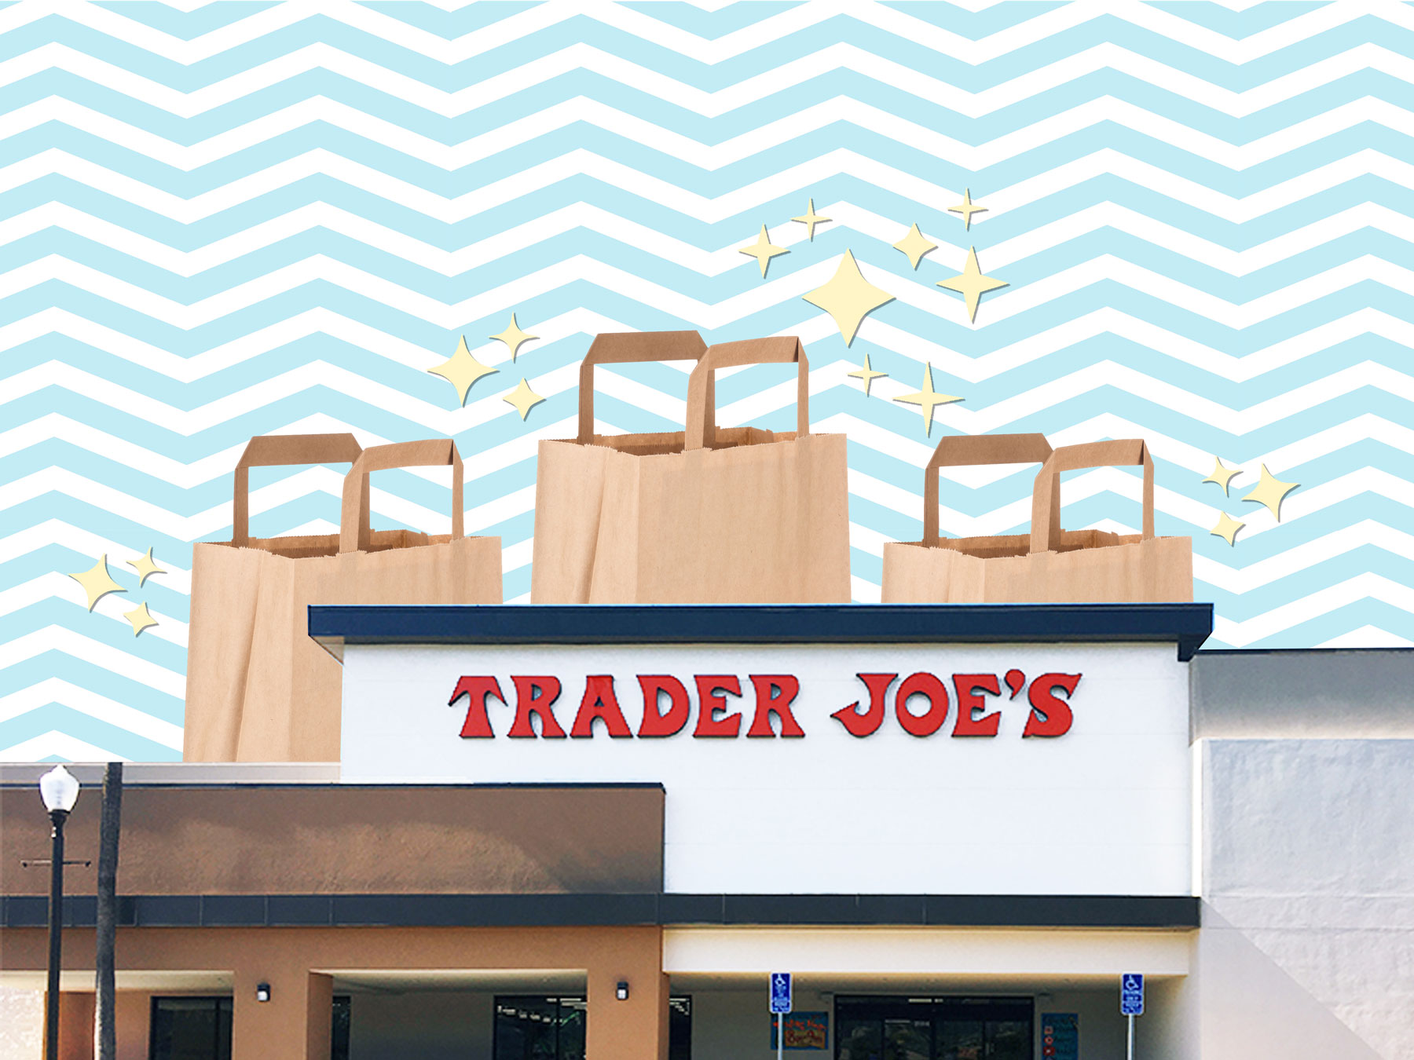

Trader Joe’s Cultural and Marketing Plan
International Business Final Project
Hailey Skoglund
Gus Lipkin
Jack Levitt

Slide 2
A Brief History
Hailey Skoglund, Jack Levitt, Gus Lipkin

Slide 3

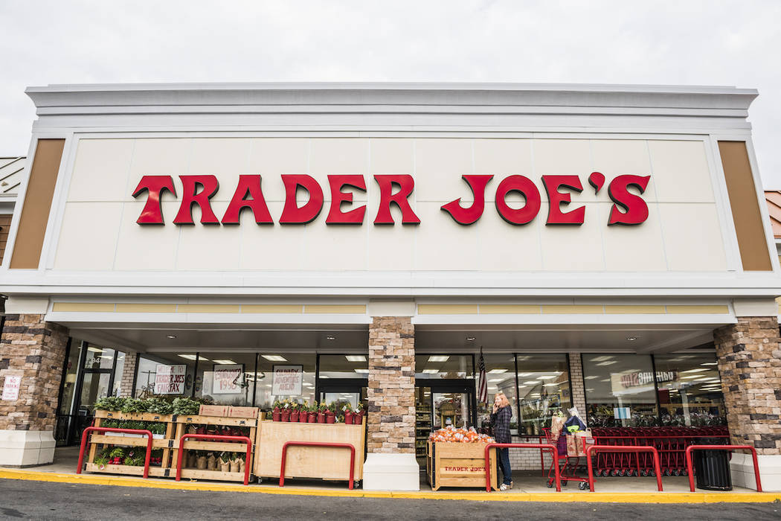
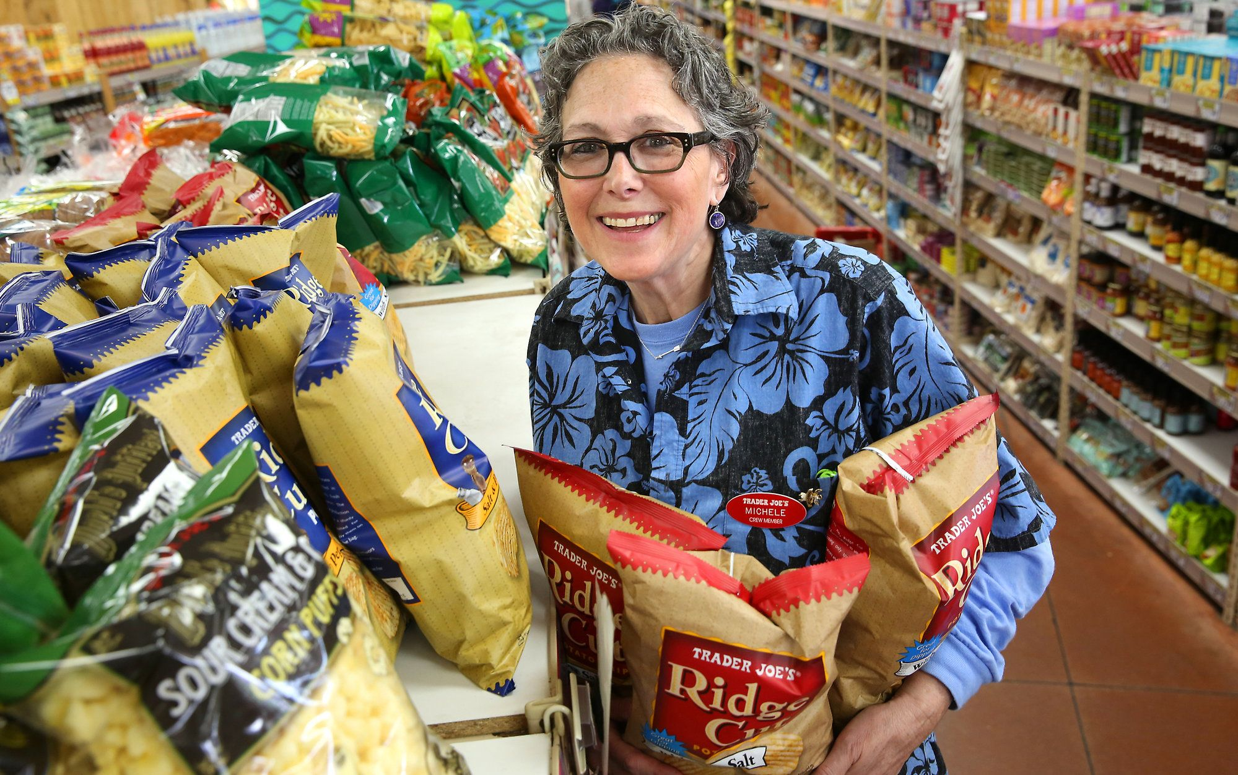
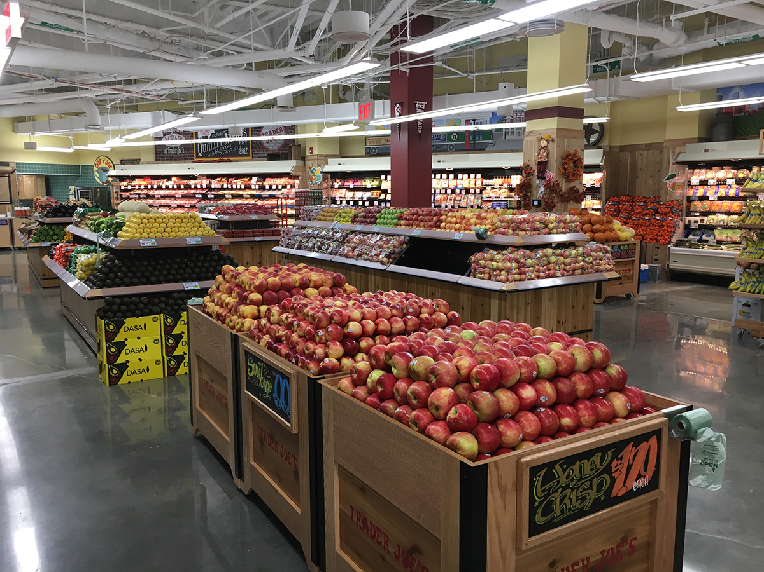
ABOUT TRADER JOE'S
Headquarters: Monrovia, California
First Opened: 1967
Current Locations: 530
Estimated Net Sales: $13.7 Billion
Hawaiian Décor
Sells Unique Items
Hailey Skoglund, Jack Levitt, Gus Lipkin

Slide 4
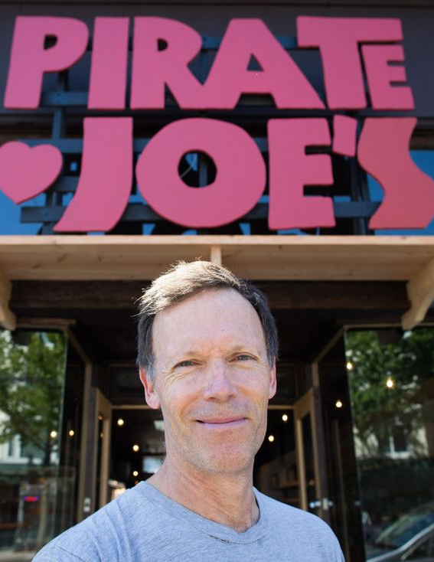
Pirate Joe’s
Pirate Joe’s was started in 2012 by Mike Hallatt located in the Kitsilano neighborhood of Vancouver
It moved to a bigger location in 2016
Trader Joe’s sued and lost when a US Federal court ruled that Trader Joe’s was not losing sales because they are not in Canada
At one point they had three vans and a warehouse to facilitate operations
Items are marked up 30% with frozen foods, coffee, wild rice, and body care products selling best
Hailey Skoglund, Jack Levitt, Gus Lipkin
Notes:
https://www.thestar.com/business/2016/07/19/its-not-quite-trader-joes-but-vancouvers-pirate-joes-is-expanding.html

Slide 5


“There are people who appreciate the selection that having Trader Joe’s products in Vancouver gives them”
Hailey Skoglund, Jack Levitt, Gus Lipkin
Notes:
https://www.thestar.com/business/2016/07/19/its-not-quite-trader-joes-but-vancouvers-pirate-joes-is-expanding.html

Slide 6
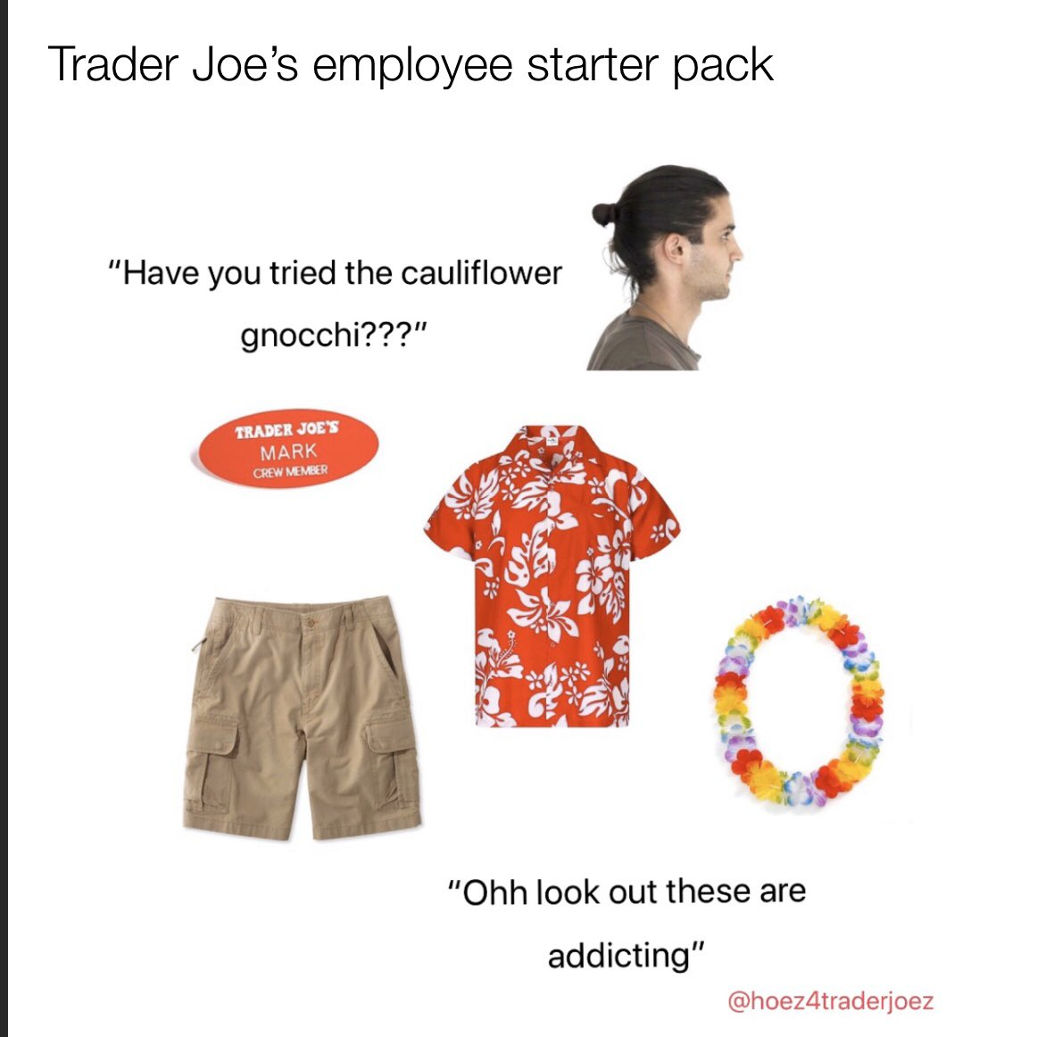
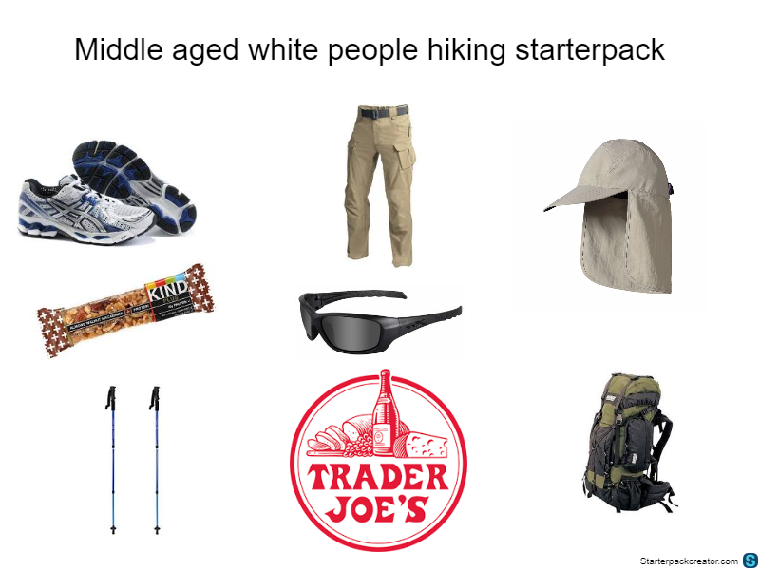
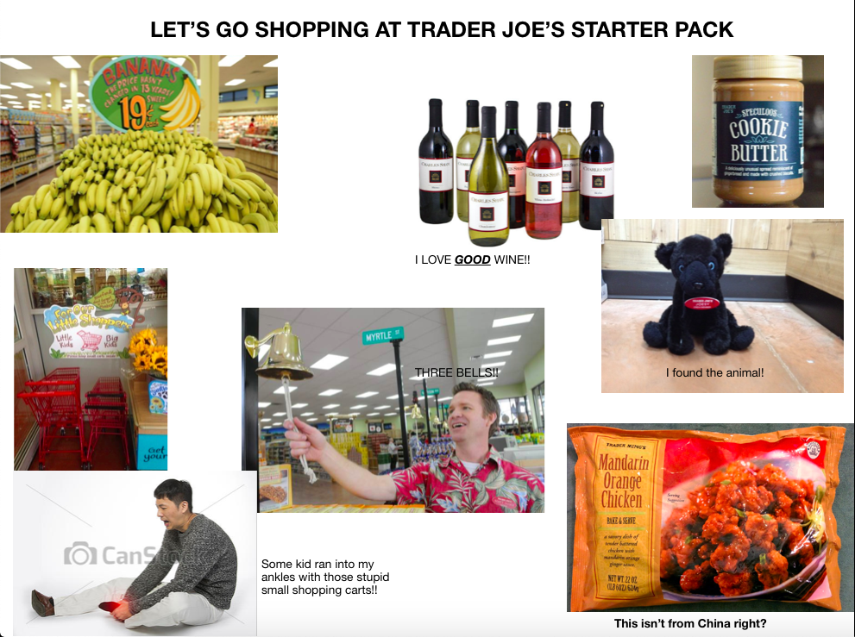
Cultural Profile
Hailey Skoglund, Jack Levitt, Gus Lipkin

Slide 7
Who shops at trader joe’s?
Data sourced from Numerator: https://snapshot.numerator.com/retailer/trader_joes
Hailey Skoglund, Jack Levitt, Gus Lipkin

Slide 8
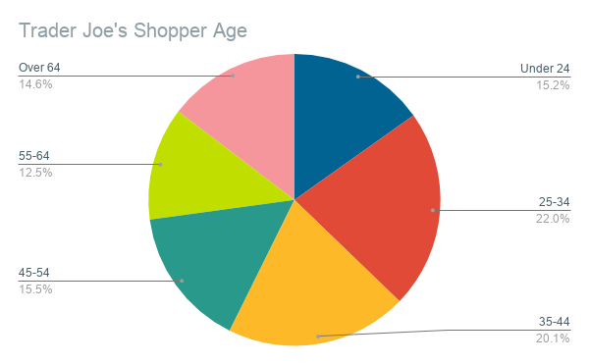
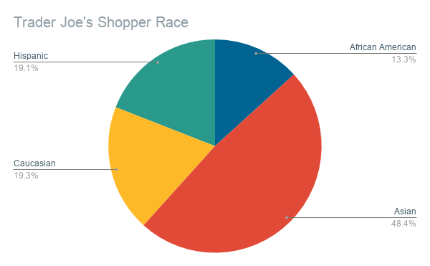
Age and Race
Roughly 50% of shoppers are middle aged (35-64)
Nearly 50% of shoppers are Asian
Hailey Skoglund, Jack Levitt, Gus Lipkin

Slide 9
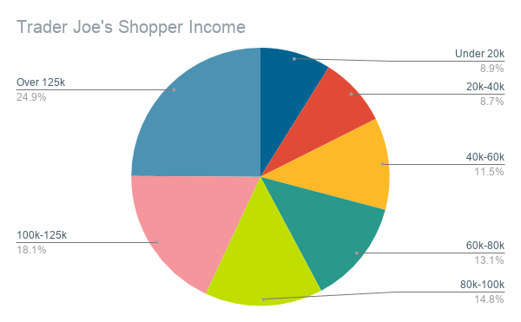
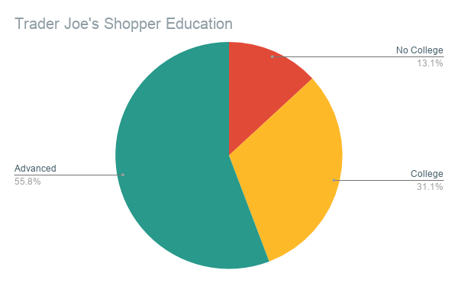
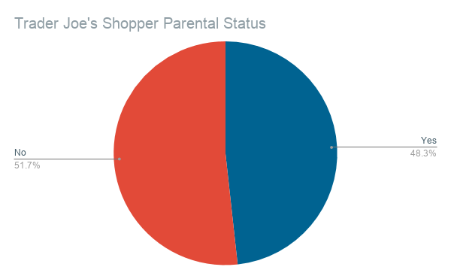
Income, education, and family
43% make over 100k a year
86.9% have a college degree or higher
48.3% are parents
Hailey Skoglund, Jack Levitt, Gus Lipkin

Slide 10
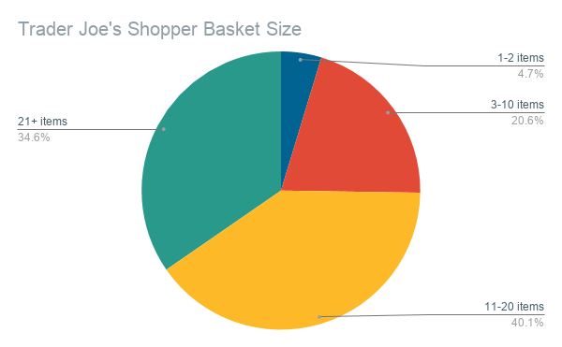
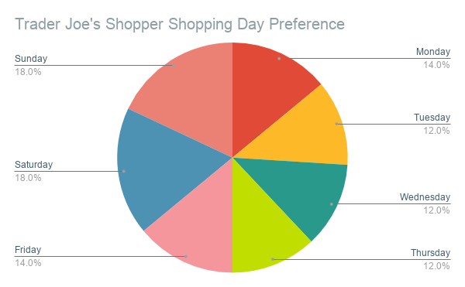
Basket Size and shopping day
74.7% have more than 10 items
50% shop on Friday, Saturday, or Sunday
Hailey Skoglund, Jack Levitt, Gus Lipkin

Slide 11
Canada vs usa
Hailey Skoglund, Jack Levitt, Gus Lipkin

Slide 12

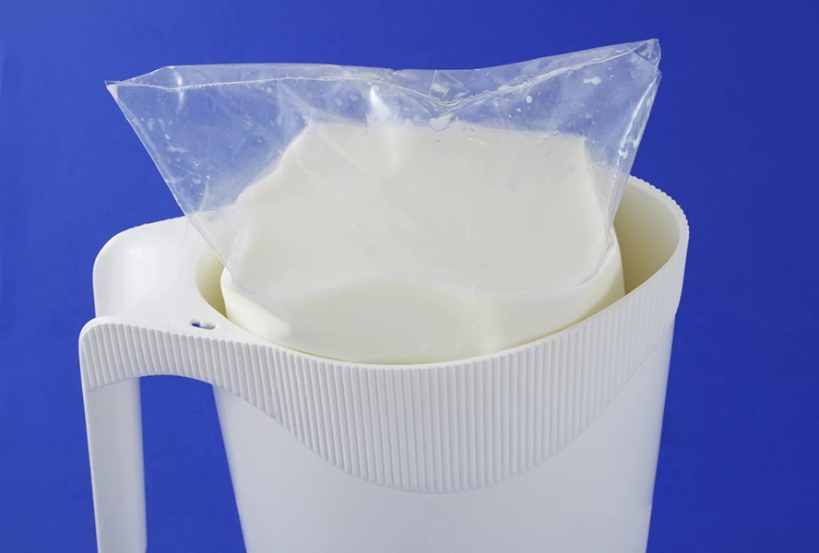
Canada's Key Differences
Canadian Consumer Packaging and Labeling Act
Net Quantity Declaration
Milk from Bags
Hailey Skoglund, Jack Levitt, Gus Lipkin

Slide 13
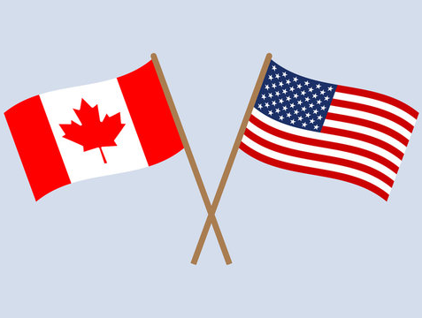
CULTURAL ANALYSIS
United States and Canada are very similar
Currently desired in the Canadian market
Subtle changes required to enter the Canadian market
Hailey Skoglund, Jack Levitt, Gus Lipkin

Slide 14


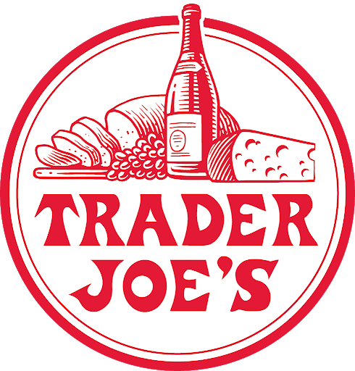

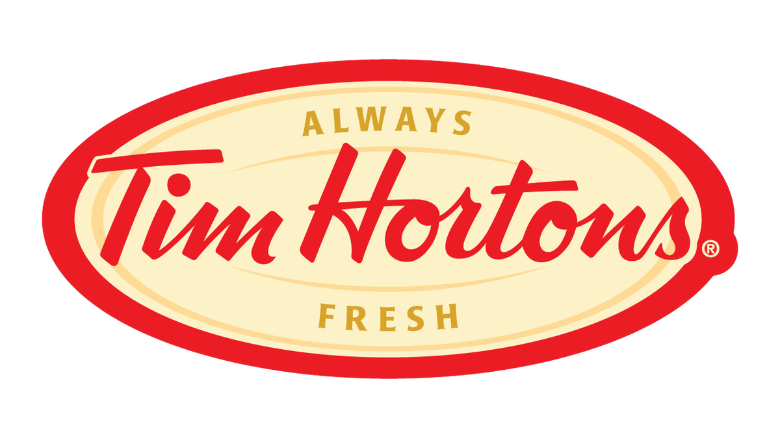


Hailey Skoglund, Jack Levitt, Gus Lipkin

Slide 15
Economic Analysis
Hailey Skoglund, Jack Levitt, Gus Lipkin

Slide 16
What do we need to know?
Is it really a good idea for Trader Joe’s to enter the Canadian market from an economic standpoint?
Market Saturation
Market Power
Competitive Entry
Market Differentiation
Hailey Skoglund, Jack Levitt, Gus Lipkin

Slide 17
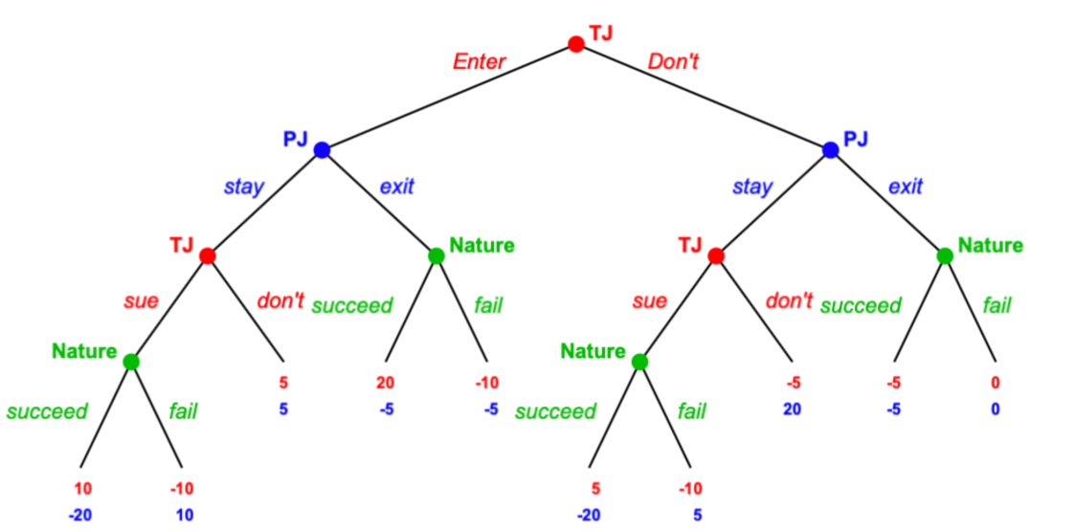
Game Theory
Players:
Trader Joe’s (TJ)
Pirate Joe’s (PJ)
Nature
Choices:
Trader Joe’s can enter the Canada market or not
Pirate Joe’s can stay in the market or exit the market
Trader Joe’s can sue Pirate Joes or not
Nature decides with probability if Trader Joe’s succeeds or fails
Hailey Skoglund, Jack Levitt, Gus Lipkin

Slide 18
Four Firm Concentration
72% of the Canadian grocery market is held by Loblaw, Metro, Sobey’s, or Safeway
The Empire Company owns Sobey’s and Safeway
Hailey Skoglund, Jack Levitt, Gus Lipkin
Notes:
https://foodpolicyforcanada.info.yorku.ca/backgrounder/problems/corporate-concentration/

Slide 19
Canadian Supermarket Grocery Sales Value (billions) in FY 2019-2020
Hailey Skoglund, Jack Levitt, Gus Lipkin

Slide 20
Canadian Supermarket Grocery Sales Value (billions) in FY 2019-2020 With Trader Joe’s US sales for the same period
Hailey Skoglund, Jack Levitt, Gus Lipkin
Notes:
https://www.cnbc.com/2020/03/09/psychology-behind-how-trader-joes-became-a-favorite-grocery-store.html#:~:text=In%202019%2C%20Trader%20Joe's%20505,according%20to%20Edge%20by%20Ascential.)

Slide 21
Marketing Strategy
Hailey Skoglund, Jack Levitt, Gus Lipkin

Slide 22
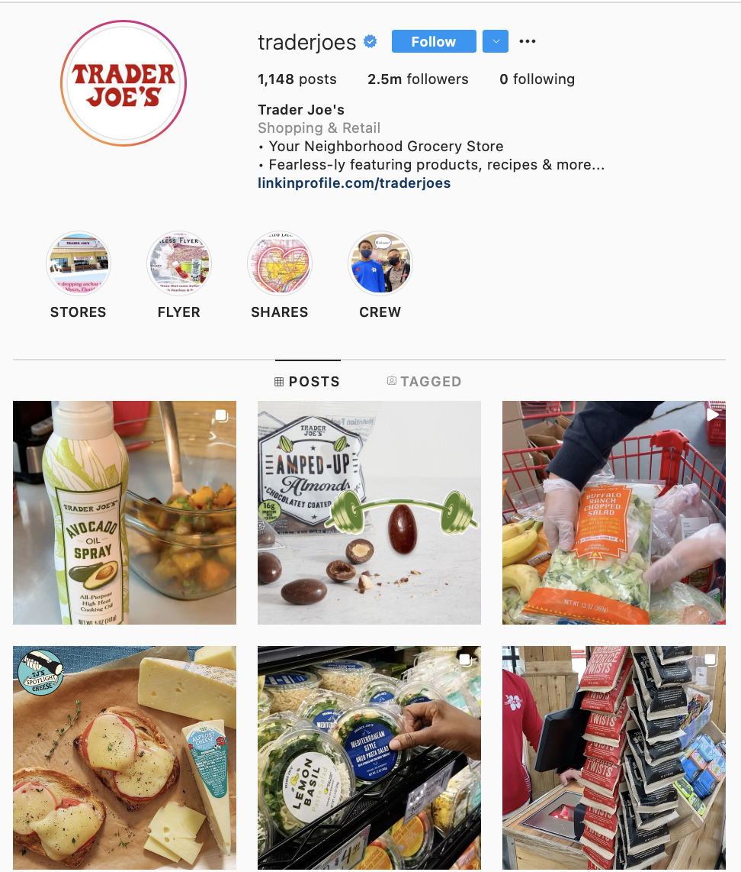
Target Market
Consumer Demographics
College graduates - young professionals in their 20's-30's
Annual household Income: $100,000+
Singles, couples, and small families
Small package sizes
Advertising
Social Media
No actual ads!
Hailey Skoglund, Jack Levitt, Gus Lipkin

Slide 23
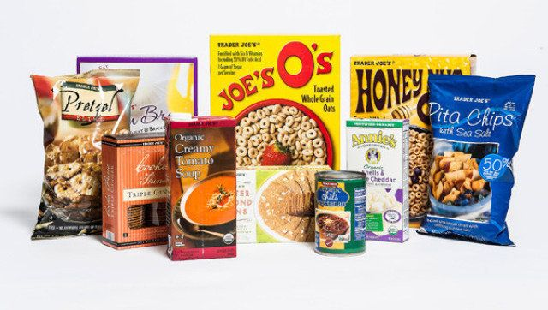
Product Differentiation
Private Label Products
agreement with third-party sellers to buy and sell products under the Trader Joe's label
Unique and interesting products that cannot be found at other grocery stores
Organic and natural foods
Wide variety, small selection
Hailey Skoglund, Jack Levitt, Gus Lipkin

Slide 24
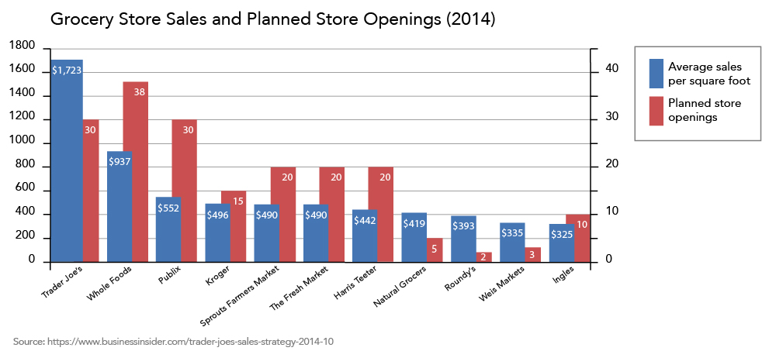
Competitors and New Entrants
Whole Foods
Publix
Kroger
Hailey Skoglund, Jack Levitt, Gus Lipkin

Slide 25
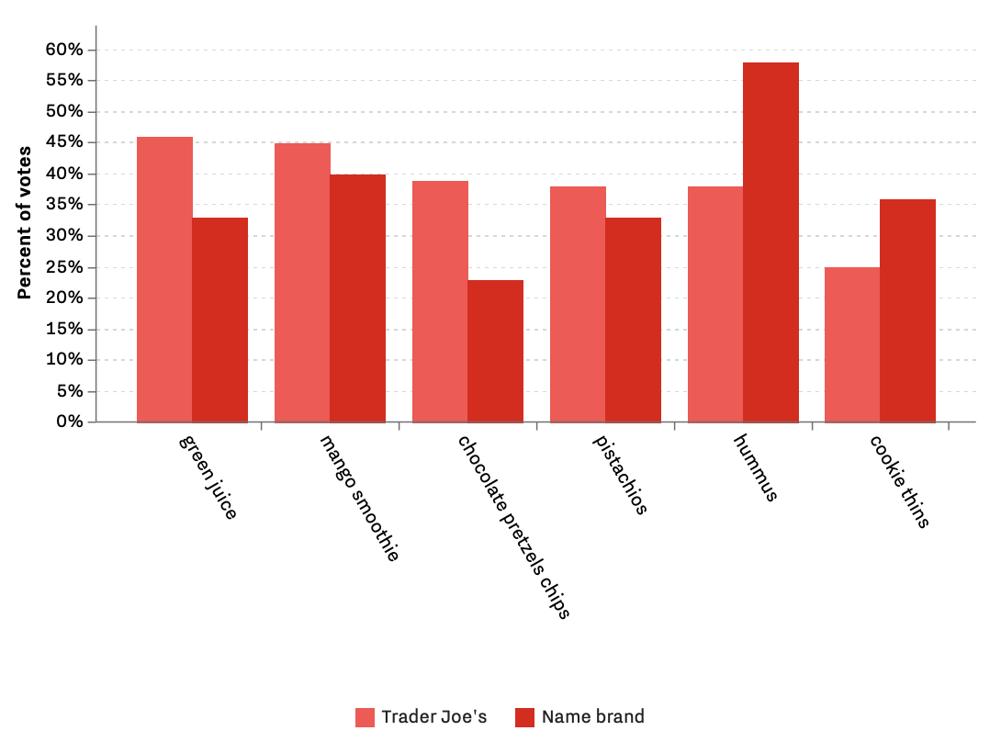
Product Substitutes
Since most of Trader Joe’s products are supplied from third-party companies, there are many substitutes at other grocery stores
By popular vote, consumers tend to prefer Trader Joe’s products a bit more
Hailey Skoglund, Jack Levitt, Gus Lipkin

Slide 26
Trader Joe’s Cultural and Marketing Plan
Questions?
International Business Final Project
Hailey Skoglund
Gus Lipkin
Jack Levitt

